Slide 1

Vendor Performance & Profitability Analysis
Unlocking true profitability beyond just revenue.

Slide 2

The Business Challenge
Lack of Clarity
Vendor Over-dependence
Unsure which vendors drive profitability, not just revenue.
Risk of relying too heavily on a few key vendors.
Eroding Margins
Identifying vendors and brands that negatively impact margins or tie up capital.

Slide 3
Project Objectives
01
02
03
Evaluate Performance
Identify Key Vendors
Target Brands
Analyze sales, cost, profit, and inventory efficiency.
Pinpoint top and low-performing suppliers.
Find brands needing promotional or pricing adjustments.
04
05
Highlight Risks
Actionable Recommendations
Expose inventory and unsold capital risks.
Provide clear guidance for procurement and management.

Slide 4

Data Overview & Metrics
Our analysis uses vendor-level sales summaries, granular by vendor, brand, and product, across 8,000+ vendors.
Total Sales & Purchase
Gross Profit & Profit Margin
Stock Turnover
Unsold Inventory Capital

Slide 5

Exploratory Data Analysis: Key Insights
1
2
Gross Profit
Profit Margin
Minimum value of -52,002.78 indicates potential losses from high costs or heavy discounts.
Minimum of -∞ suggests cases of zero or negative revenue vs. total cost.
3
Zero Sales
Some products purchased but never sold, indicating slow-moving or obsolete inventory.

Slide 6

Outliers & Data Filtering
Outliers Detected
Data Filtering
Purchase & Actual Price: Max values (5,681.81 & 7,499.99) much higher than means (24.39 & 35.64), showing premium products.
Inconsistent data points removed for reliability:
Gross Profit ≤ 0
Profit Margin ≤ 0
Freight Cost: Extreme variation (0.09 to 257,032.07) suggests logistics inefficiencies.
Total Sales Quantity = 0
Stock Turnover: Ranges from 0 to 274.5, indicating varied sales speeds.

Slide 7
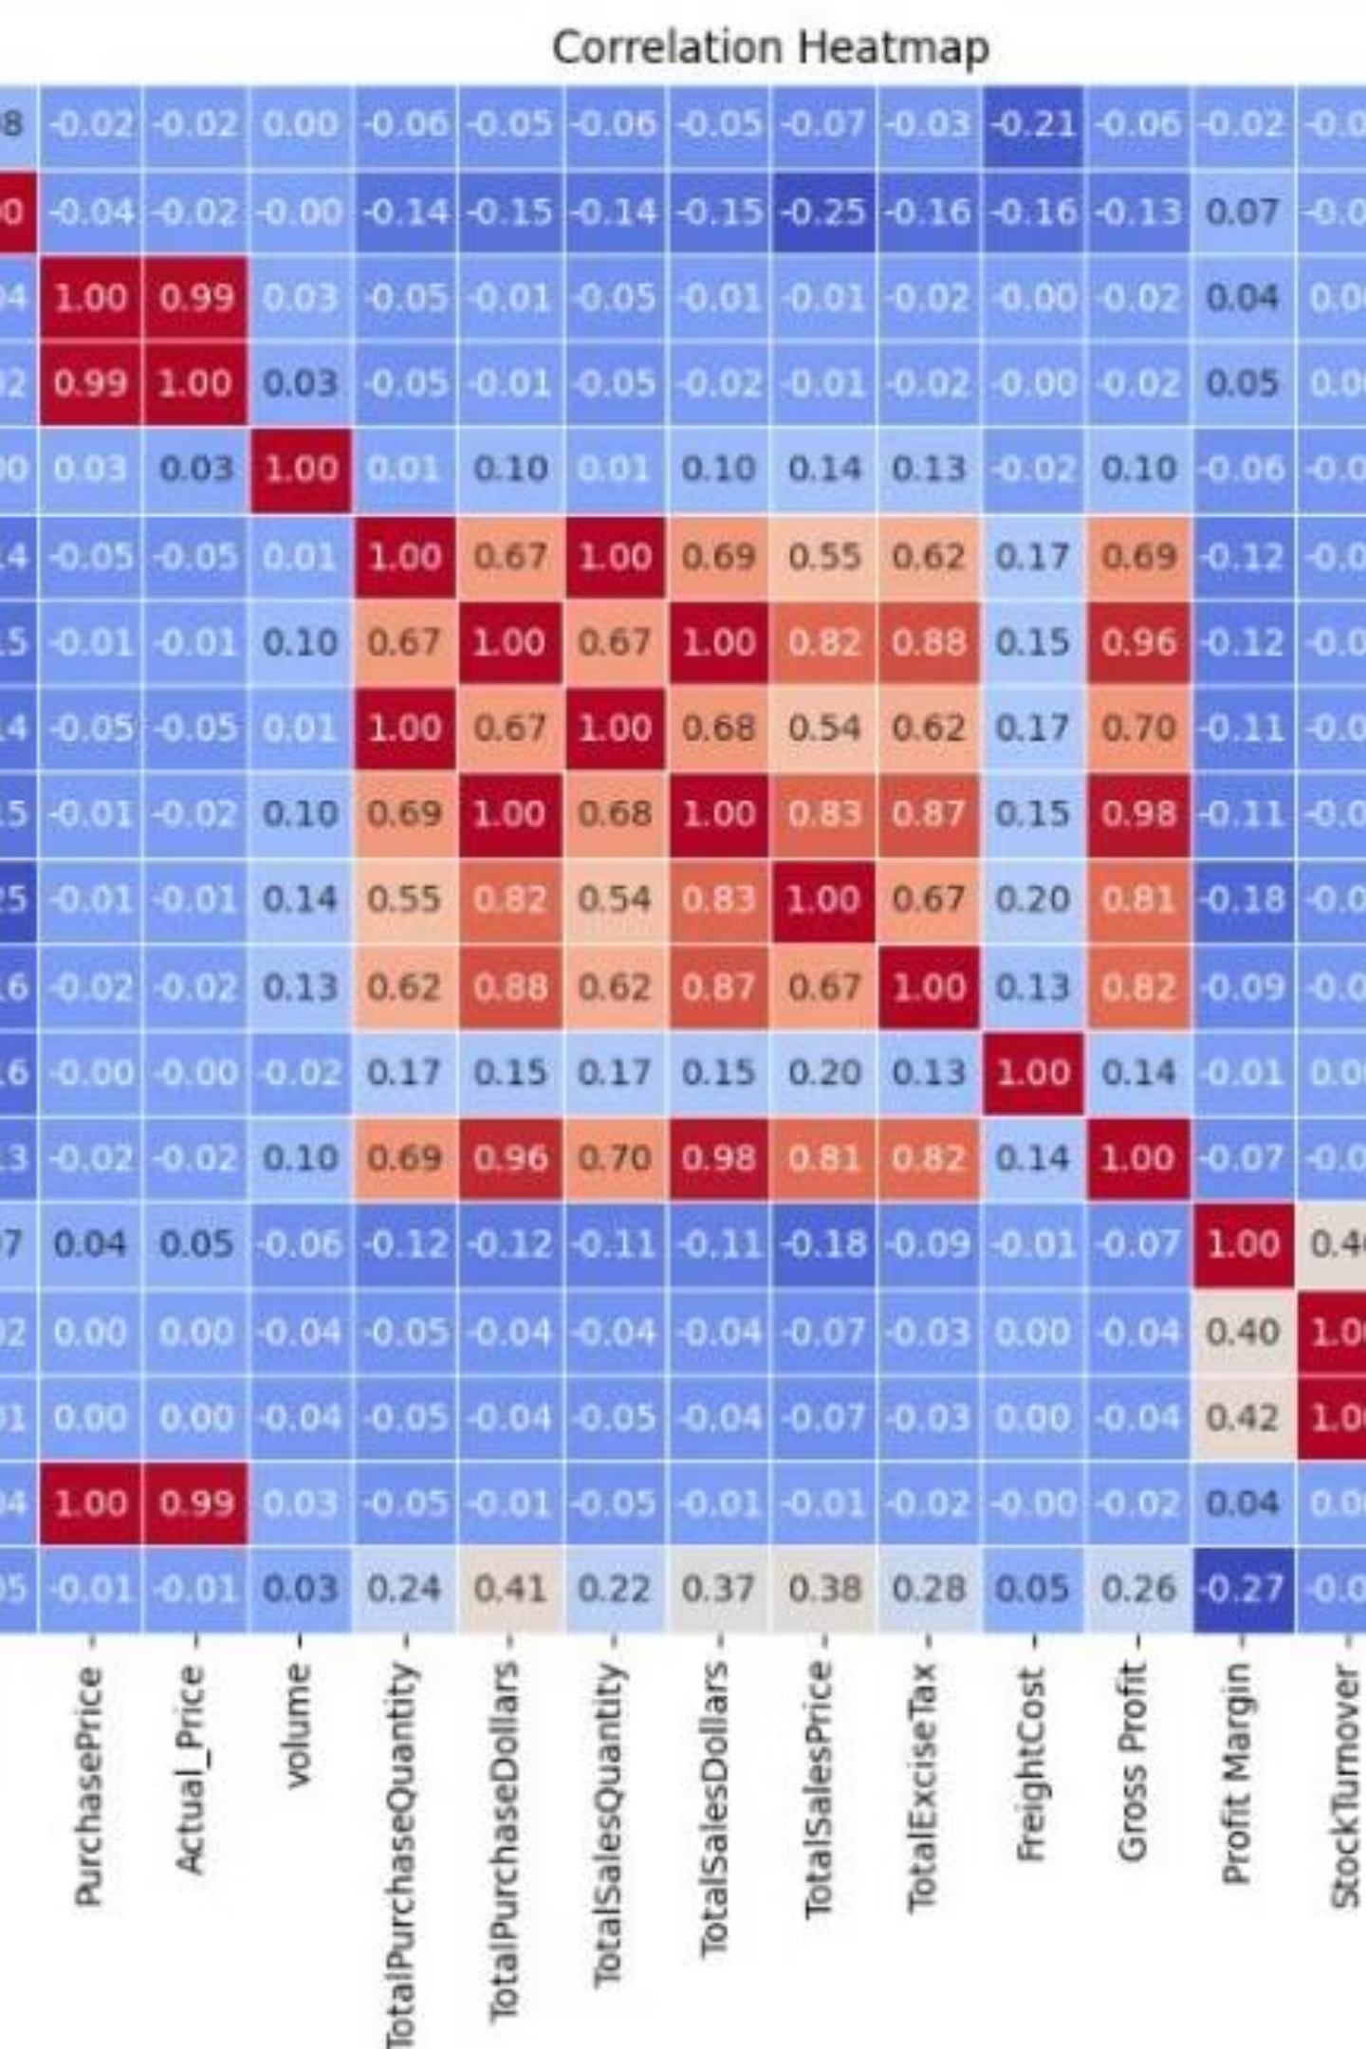
Correlation Analysis
Purchase Price vs. Sales/Profit
Weak negative correlation (-0.012 & -0.016); purchase price variations don't significantly impact sales or gross profit.
Purchase vs. Sales Quantity
Strong positive correlation (0.999) confirms efficient inventory movement.
Profit Margin vs. Sales Price
Negative correlation (-0.179) suggests higher sales prices may reduce margins due to competition.
Stock Turnover vs. Profit
Weak negative correlations (-0.038 & -0.055); faster turnover doesn't always mean higher profitability.

Slide 8

Key Findings: Brands & Vendors
Brands for Promotion
Top Vendors & Risk
198 brands have low sales but high profit margins. These are opportunities for targeted marketing or pricing optimization.
Top 10 vendors account for 65.69% of total purchases, creating high dependence and supply chain risk.
Concannon Glen Ellen Wh Zin: 83.45% margin
Crown Royal Apple: 89.81% margin
DIAGEO NORTH AMERICA INC
MARTIGNETTI COMPANIES
PERNOD RICARD USA
JIM BEAM BRANDS COMPANY
BACARDI USA INC
CONSTELLATION BRANDS
BROWN-FORMAN CORP
E & J GALLO WINERY
ULTRA BEVERAGE COMPANY LLP
Other Vendors

Slide 9

Inventory & Capital Risks
Bulk Purchasing Savings
Unsold Inventory Capital
Large orders average 72% lower unit cost ($10.78), incentivizing bulk to increase sales and profitability.
Total of $2.71M tied up in slow-moving stock, increasing costs and reducing cash flow.
Low Inventory Turnover
Identifying vendors with slow turnover helps improve stock planning and minimize financial strain.

Slide 10

Final Recommendations
Re-evaluate Pricing
Adjust strategies for low-sales, high-margin brands to boost volume.
Diversify Vendors
Reduce dependency on a few suppliers to mitigate supply-chain risks.
Leverage Bulk Buys
Utilize bulk purchasing for competitive pricing and inventory efficiency.
Optimize Slow Inventory
Adjust purchases, clear stock, or revise storage for slow-moving items.
Enhance Marketing
Boost efforts for low-performing vendors to increase sales without eroding margins.
Implementing these recommendations will improve profitability, reduce risks, and enhance operational efficiency.

